Slide 1

SEM V MINI PROJECT
THIRD EYE FOR BLIND
- JISHNU PISHARODY (32)
- ADITYA RATHOR (34)
- SAHEB SINGH SANDHU (36)
- ABHISHEK SINGH (41)

Slide 2
INTRODUCTION
The Third Eye for Blind is designed to help the blind to overcome the lack of visual sense, by using other senses like sound and touch.
It uses audio and vibration signals to notify the user about upcoming hurdles.
As the distance between person and obstacle decreases, frequency of both audio and vibration signals increases.
Thus the system helps to ease the navigation process for the needy.

Slide 3
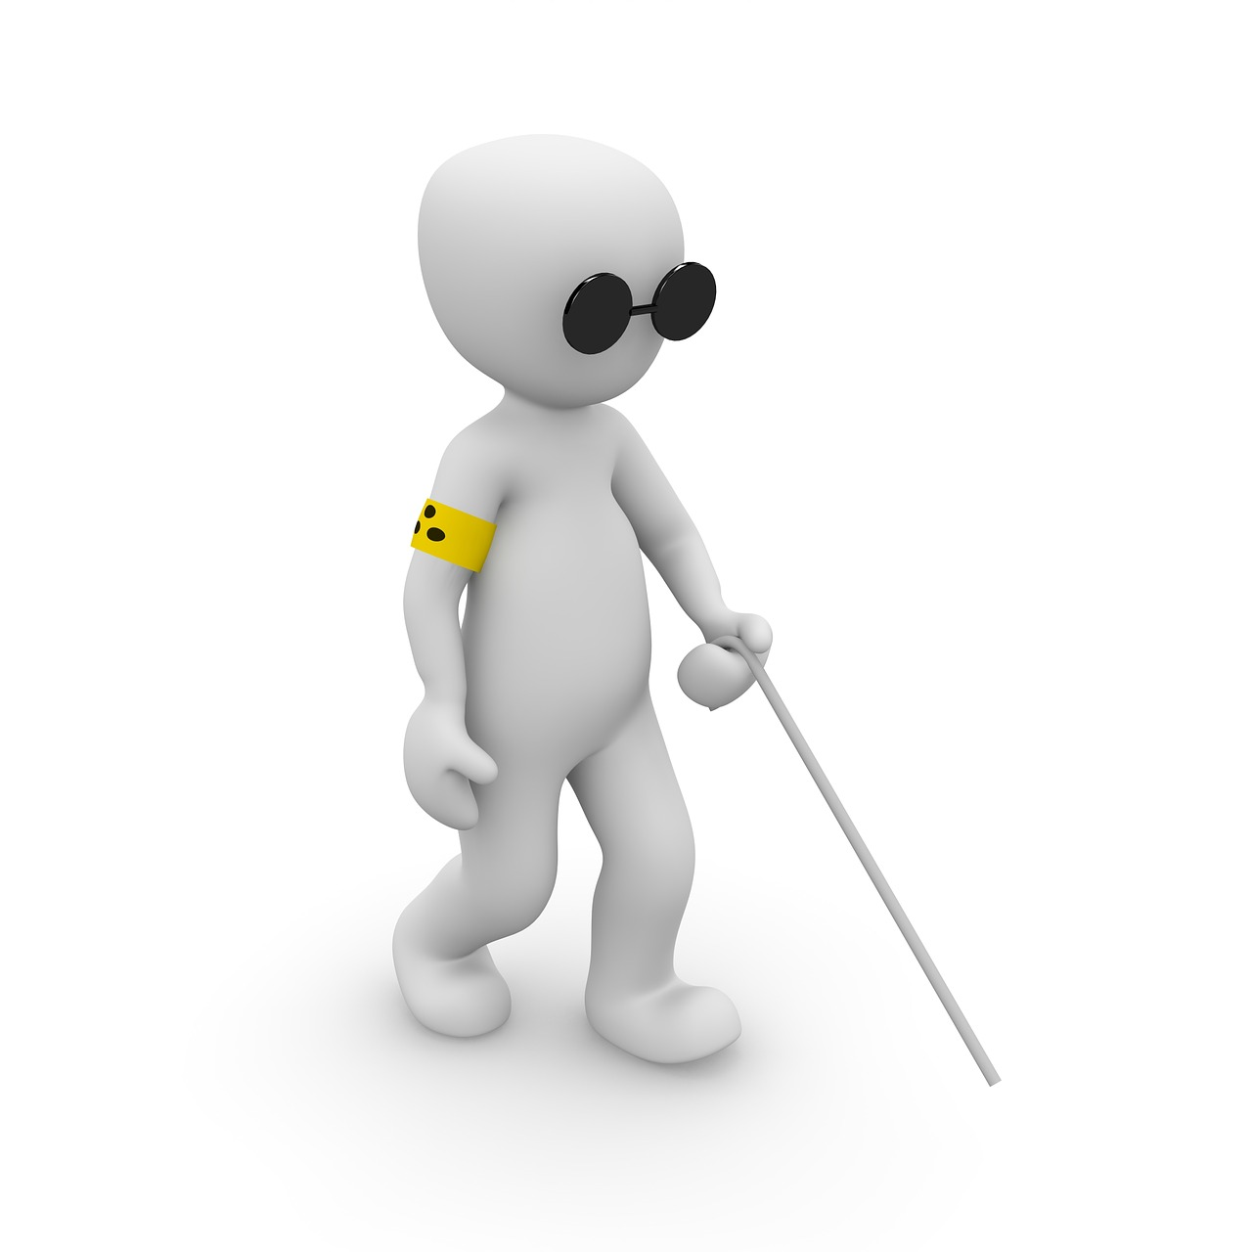
PURPOSE
According to WHO 39 million peoples are estimated as blinds worldwide.
They are suffering a lot of hardships in there daily life.
So the aim of the project is to develop a cheap and more efficient way to help visually impaired to navigate with greater comfort, speed and confidence.

Slide 4
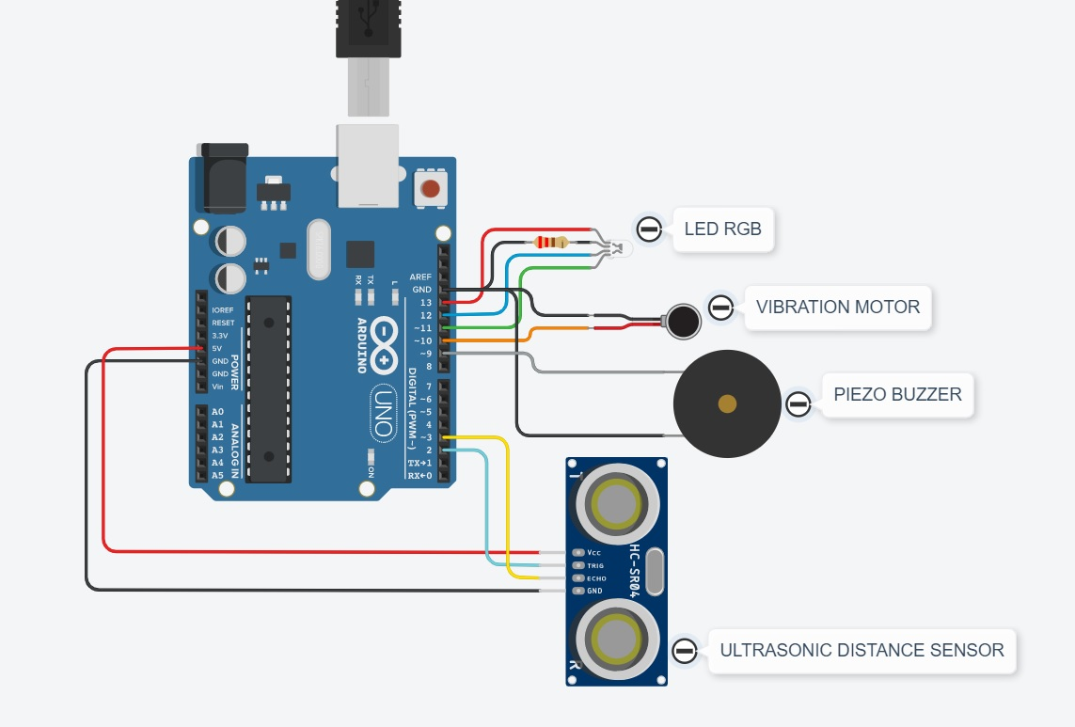
CIRCUIT DIAGRAM

Slide 5
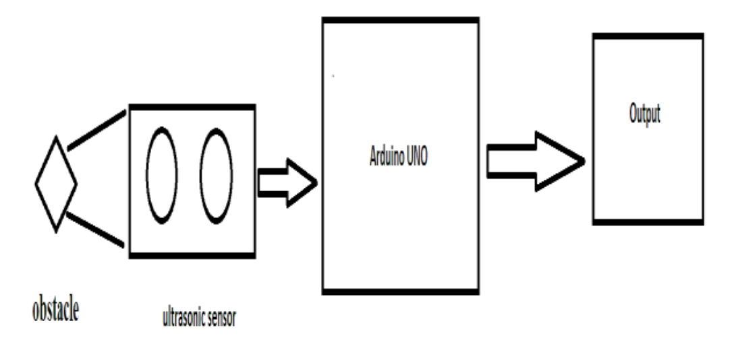
WORKING
When we increase the distance between the object and the sensor the coverage angle will decrease. Sensor has coverage of 60 degree.
Thus, the objective is to cover a wide angle to detect the obstacles with the help of the ultrasonic sensors to help the blind and make it easy for them to move around easily without any hassle.
Hence, the distance calculation is calculated and the sensor detects and the further procedure of the buzzing sound to the user is carried out.

Slide 6
CODE

Slide 7
ADVANTAGES
It can detect objects around a considerably wide range of 11m.
It is a cost effective project.
Injuries can be avoided due to this device.
This system is applicable for both the indoor and outdoor environment.
Less power consumption.
Low design time.

Slide 8
APPLICATIONS
This project is applied mainly in the commercial field of helping visually impaired people with lower eyesight or those that are completely blind.
Industrial applications can be devised and enhanced like robots and machineries.
Concept can be used for Autonomous cars.
Can also be used for security purposes, identifying and tracking objects etc.

Slide 9
CONCLUSION
The main purpose of this study is to produce a prototype that can detect objects or obstacles in front of users and feeds warning back, in the form of vibrations, to user.
This project is beneficial for people that are blind, to facilitate the movement and increase safety.
It is a less complex portable, cost efficient, easy to manage an effective system with many more amazing properties and advantages are proposed to provide support for the blind.

Slide 10
THANK YOU

